Slide 1
Lecture 7: Continuous Model and Differential Equations
Using mathematical tools to explore real-world problems.
Ref: Textbook Chapter 11

Slide 2
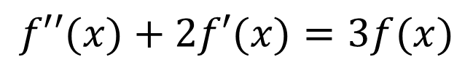
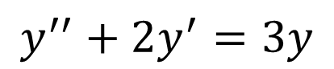
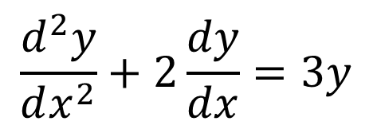
Differential Equations
$$y^{′′}+2y^{′}=3y$$
$$f′′(x)+2f′(x)=3f(x)$$
$$\frac{d^{2}y}{dx^{2}}+2\frac{dy}{dx}=3y$$
These are different forms of the same differential equation.

Slide 3
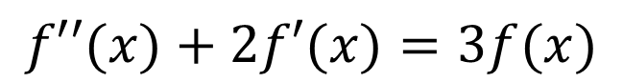
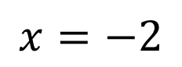
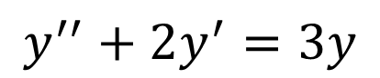
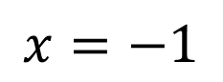
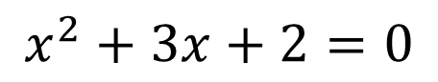
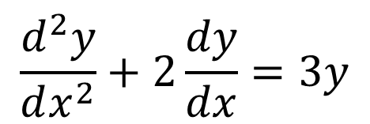
Differential Equations
Differential equations
Algebraic equations
$$y^{′′}+2y^{′}=3y$$
$$x^{2}+3x+2=0$$
$$f′′(x)+2f′(x)=3f(x)$$
$$x=−1$$
or
$$x=−2$$
$$\frac{d^{2}y}{dx^{2}}+2\frac{dy}{dx}=3y$$
Solution: function(s)
Solution: value(s)

Slide 4
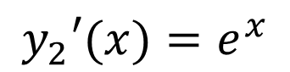
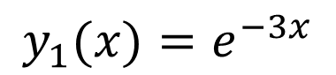
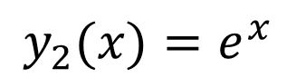
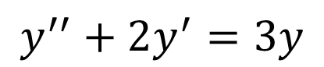
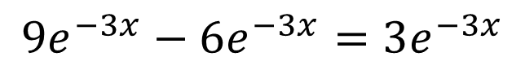
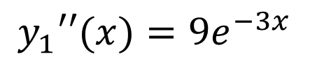
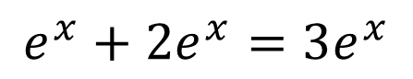
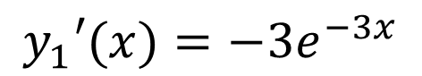
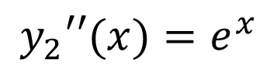
Differential Equations
Two possible solutions of
$$y^{′′}+2y^{′}=3y$$
$$y_{1}(x)=e^{−3x}$$
$$y_{2}(x)=e^{x}$$
$$y_{1}′(x)={−3e}^{−3x}$$
$$y_{2}′(x)=e^{x}$$
$$y_{1}′′(x)={9e}^{−3x}$$
$$y_{2}′′(x)=e^{x}$$
$$9e^{−3x}−6e^{−3x}=3e^{−3x}$$
$$e^{x}+2e^{x}=3e^{x}$$

Slide 5
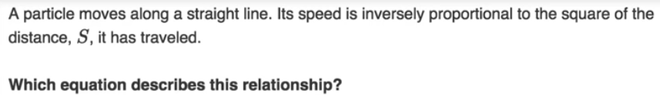
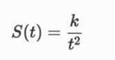
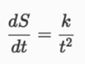
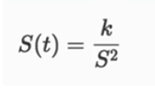
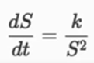
Differential Equations
Differential equations describe rate of change

Slide 6
Slope field (graphical analysis)
A slope field is a collection of the solution curves of a differential equation
A solution curve is a short line segment that equals to the slope that the solution of the differential equation should have at a particular point
Slope field gives a graphical illustration of what the solutions might look like (given points that solutions might actually contain)

Slide 7
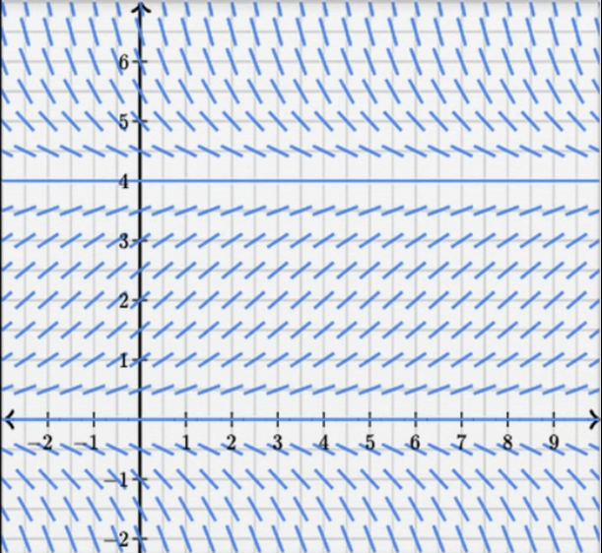
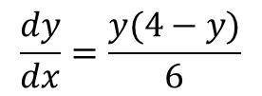
Slope field for
$$\frac{dy}{dx}=\frac{y(4−y)}{6}$$

Slide 8
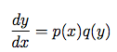
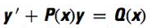
Analytical solutions
Certain differential equations can be solved analytically
Separable equations
First-order linear equations

Slide 9
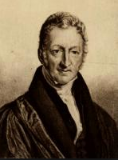
Thomas Malthus (1766-1834)
British scholar
Influential in demography and political economy
Proposed an exponential growth model for population growth in his famous book “An Essay on the Principle of Population”

Slide 10
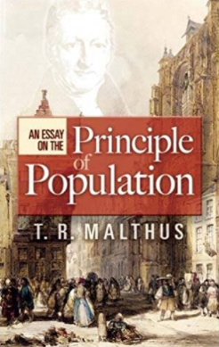
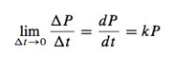
Exponential growth model
Assumption: the average rate of change of the population over an interval of time is proportional to the size of the population
Solve for P:
where P₀ is the population at time t = 0.

Slide 11
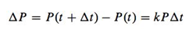
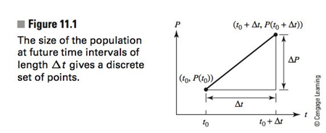
Review: Difference equation v. Differential equation
Consider the population of certain species grows proportionally, we have the following relationship:
Difference equation (discrete):
Differential equation (continuous):

Slide 12
Discrete & continuous compounding
Compound return of a certain investment is the rate of return that represents the cumulative effect that a series of gains or losses have on an original amount of capital over a period of time.
The frequency of compounding has an impact on the effective return (the money you can get eventually).

Slide 13
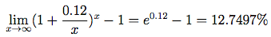
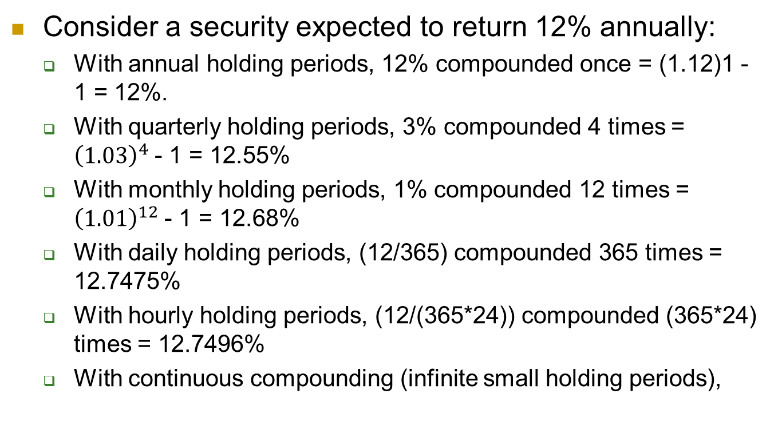
Discrete & continuous compounding
Consider a security expected to return 12% annually:
With annual holding periods, 12% compounded once = (1.12)1 - 1 = 12%.
With quarterly holding periods, 3% compounded 4 times = ${\left(1.03\right)}^{4}$- 1 = 12.55%
With monthly holding periods, 1% compounded 12 times = ${\left(1.01\right)}^{12}$- 1 = 12.68%
With daily holding periods, (12/365) compounded 365 times = 12.7475%
With hourly holding periods, (12/(365*24)) compounded (365*24) times = 12.7496%
With continuous compounding (infinite small holding periods),

Slide 14
Derivative as a rate of change
The derivative is used in two distinct roles:
To represent the instantaneous rate of change in continuous problems.
To approximate an average rate of change in discrete problems.

Slide 15
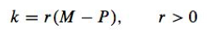
Logistic growth model (limited growth)
We can refine the exponential growth model by changing the growth rate k to
to reflect limited growth. M is the maximum population allowed (given constraint on resources, space, etc.).

Slide 16
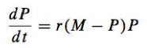
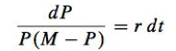
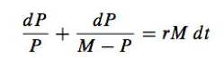
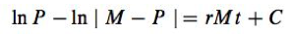
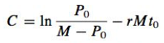
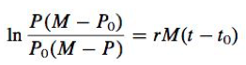
Solve P in
Take integrals,
Solve for constant C, consider P < M
(the equation must hold when P = P₀ and t = t₀)
Therefore,

Slide 17
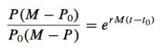
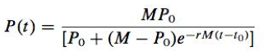
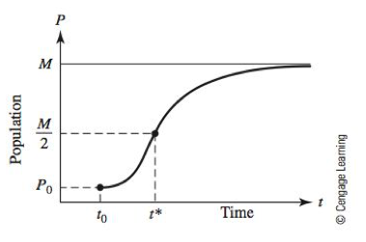
Exponentiating both sides,
So solve for population P as a function of time t,
Note that the second derivative
is 0 when P = M/2, which means the maximum rate of growth occurs at P = M/2.
The logistic curve

Slide 18
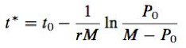
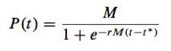
Alternative form of the logistic equation
Let t* denote the time when the population P reaches half of the limiting value, namely

Slide 19
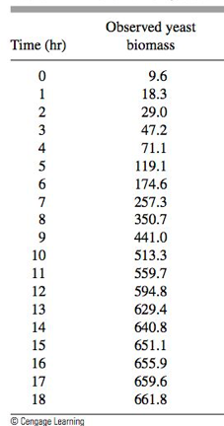
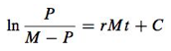
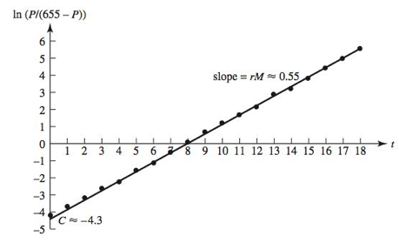
Yeast population
Slope
Intercept
Estimating limit

Slide 20
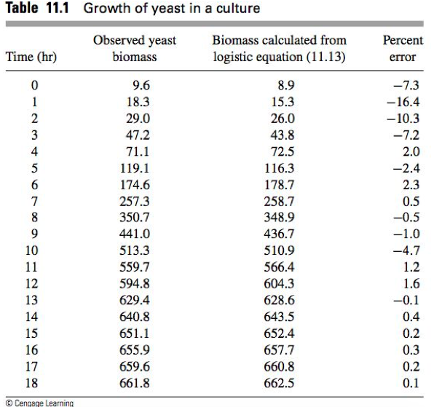




Slide 21


U.S. population
Why does this model fail to predict the population as time goes on?

Slide 22


Example 1: drug dosage (p. 471)
The concentration of drug in blood decreases over time after a dosage
How can the doses (C₀) and the time (T) between doses be adjusted to maintain a safe but effective concentration of the drug in the blood? (Ignoring other factors)

Slide 23


Clinical experiments have revealed that the decrease in the concentration of a drug in the bloodstream will be proportional to the concentration.
Therefore, without additional dosage, the concentration C(t) satisfies
Further assume that the concentrations H and L can be determined experimentally for a given population
The drug concentration of a single dose can be determined by

Slide 24

If we assume that C₀ is the concentration at
t = 0, then we have the model

Slide 25

Further assume that when a drug is taken, it is diffused so rapidly throughout the blood that the graph of the concentration for the absorption period is, for all practical purposes, vertical.

Slide 26




Concentration at the beginning of ith interval
Concentration at the end of ith interval

Slide 27




If the desired concentration level is required to approach H as n becomes large, we need
Note that C₀ = H – L, therefore we have
R = L
Thus solve for T in

Slide 28

Conclusion: dosage schedule

Slide 29


Graphical solutions of differential equations
Graphical solutions give an intuitive understanding on system behaviour with different initial values.

Slide 30



Autonomous function
A differential equation for which dy/dx is a function of y only is called an autonomous differential equation.
Example:
Changes in y are dependent on y only, not dependent on x.

Slide 31


Steps for obtaining a graphical solution of autonomous function
1. Draw a number line for y and mark the equilibrium values (y’ = 0, or rest points)
Example:

Slide 32


Steps for obtaining a graphical solution of autonomous function
2. Identify and label the intervals of y’>0 and y’<0
Example:

Slide 33


3. Calculate y’’ and mark the intervals for y’’>0 and y’’<0

Slide 34

4. Sketch an assortment of solution curves in the xy-plane

Slide 35
Stable and unstable equilibrium
If the curve is at the equilibrium values y = -1 or y = 2, it will stay at that value;
Any curves with value near y = -1 will tend steadily towards that value. y = -1 is a stable equilibrium;
Any curves with value near y = 2 will move away from that value. y = 2 is an unstable equilibrium.

Slide 36
Example 2: cooling soup (p. 487)
What happens to the temperature of a cup of hot soup when it is placed on a table in a room?
What does a typical temperature curve look like as a function of time?
Suppose that the surrounding medium has a constant temperature of 15 ºC.

Slide 37

Problem formulation: we assume that the soup’s Celsius temperature H is a differentiable function of time t . Choose a suitable unit for t (e.g., minutes) and start measuring time at t = 0. We also assume that the volume of the surrounding medium is large enough so that the heat of the soup has a negligible effect on its surrounding temperature.
According to Newton’s law of cooling, there exists a positive constant k such that

Slide 38





Slide 39




Logistic growth revisited

Slide 40


Slide 41

First-order initial value problems
We call functions with the general form
first-order initial value problems.
Three components
Differential equation
Initial value
Interval

Slide 42

Approximation solution to initial value problems
Initial value problems are usually difficult to solve except for some special cases (e.g., autonomous differential equation).
Therefore, we need some numerical method to solve such problem
Given the differential equation and initial value, we can get an approximation

Slide 43



Slide 44


Euler’s Method: put together a string of tangent line approximations to the curve over a longer stretch
…
Only involve simple additions and multiplications

Slide 45

Example 3: Saving certificate (p. 494)
We consider the value of a certificate initially worth $1000 that accumulates annual interest at 12% compounded continuously
Use Euler’s method to approximate the value in 10 years using

Slide 46


Smaller step size generally leads to greater accuracy but requires more computations (may introduce round-off error)

Slide 47





Separation of variables
Consider a function in the form
We may rewrite the function as (when q(y) is not 0)
Integrate both sides,
where
namely

Slide 48


Example 4: Separation of variables (p. 502)
Verification:

Slide 49

Differential form
Generally, the differential form of a first-order differential equation is
Examples
Not separable!
Exercise: solve the first two functions

Slide 50





More on differential equations
The first-order linear equation is an equation with the form
or
Examples
NOT first-order linear equations

Slide 51





Solving first-order linear equations
Consider the general form
Multiply both sides by (integrating factor)
Obtain
Note that
Therefore

Slide 52

Integrating both sides of
We have
Then y can be solved explicitly by dividing both sides by

Slide 53

Example 5: First-order linear equation (p. 518)
Find the solution of
Satisfying y(1) = 2

Slide 54





Step 1: transfer to the general form
Step 2: calculate the integrating factor
Step 3: multiply the RHS by the integrating factor and integrate

Slide 55



Step 4: obtain the general solution
Step 5: solve for C and obtain the particular solution

Slide 56
Example 6: water pollution (p. 519)
Suppose a large lake that was formed by damming a river holds initially 100 million gallons of water. Because a nearby agricultural field was sprayed with a pesticide, the water has become contaminated. The concentration of the pesticide has been measured and is equal to 35 ppm (parts per million)
The river continues to flow into the lake at a rate of 300 gal/min. The river is only slightly contaminated with pesticide and has a concentration of 5 ppm. The flow of water over the dam can be controlled and is set at 400 gal/min. Assume that no additional spraying causes the lake to become even more contaminated. How long will it be before the water reaches an acceptable level of concentration equal to 15 ppm?

Slide 57
Problem formulation: The concentration c(t) is the ratio of the amount of the pollutant p(t) to the volume of the lake V(t)
Assume that when water enters the lake, perfect mixing occurs, so that the pollutants are uniformly distributed throughout the lake at any time.
Assume also that the pollutants are not removed from the lake by sedimentation, decay, or any other natural mechanism except the outflow of water from the lake.

Slide 58






Volume as a function of time
Change in the amount of pollutant

Slide 59





The integrating factor
The general solution

Slide 60


The particular solution, taking t = 0 and p(0) = c(0)V(0) = 3500
The problem asks for the time t when the concentration level
Solve t for

Slide 61
Uniqueness of solutions
Existence and uniqueness theorem: There is one and only one solution y=y(x) satisfying the first-order linear equation
on a specified interval and the initial condition
at a specified point in the interval.
Nonlinear equations may have more than one solution.

